Slide 1
Matting 101
NVPS - Education and Training
Oct 11, 2016

Slide 2
Matting Options
Pre-cut mats – perfect cuts and bevels, many standard sizes
Custom cut mats – can be sized to exactly fit your image
Pre-cut mats come in various sizes to fit most standard sized images. Examples:
8x10” mat with window for 5x7 or 6x8 prints
11x14” mat with window for 8x10 or 8x12 prints
16x20” mat for 11x14 print
18x24” mat with window for 13x19 or 12x18 prints
Size of cutout you use depends on how you want to crop or not crop an image
Many camera’s use (3:2) aspect ratio as standard
Full frame (36x24mm), APS-C (23.6x15.7mm), 1” (13.2x8.8mm)
Micro 4/3 (17.3x13mm) slightly different ratio
Different aspect ratios are selectable in camera (software crop)
Canon - 3:2, 4:3, 1:1, 16:9
Nikon - 3:2, 4:3, 5:4, 1:1, 16:9

Slide 3
Matting Options – Pre-cut
Example:
Pre-cut 11x14 mat with 8x12” window
Would not require cropping if image/print was 3:2 aspect ratio
Pre-cut 11x14 mat with 8x10” window
Would crop 2” if image/print was 3:2 aspect ratio
You can crop it while printing or print full image and let the mat do the cropping
If you shoot images in the 3:2 ratio and you don’t want to crop them, print images in 4x6, 8x12, 12x18 inch format
Buy mat sizes/cutout to match the uncropped images
8x10 with 4x6 cutout
11x14 with 8x12 cutout
16x24 with 12x18 cutout

Slide 4
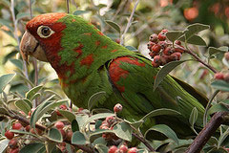
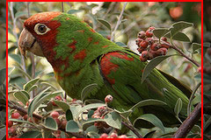
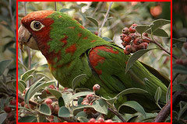
Aspect ratio for printing/matting
4x6 or 8x12 mat window
Image shot and printed in 3:2 Aspect Ratio
5x7 mat window
8x10 mat window

Slide 5
Cropping with your Mat
11x14 Mat
11x14 Mat
with
with
8x12 Cutout
8x10 Cutout
Image crop to fit cutout
3:2 aspect print
3:2 aspect print

Slide 6
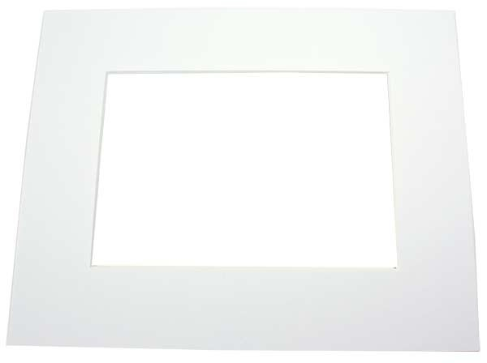
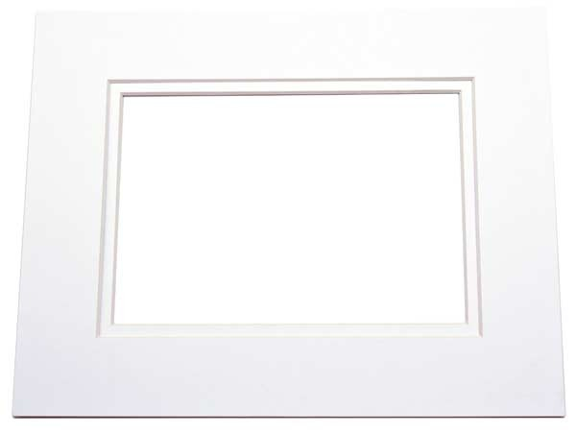
Different matting within standard sized mats
Single or double pre-cut mats

Slide 7
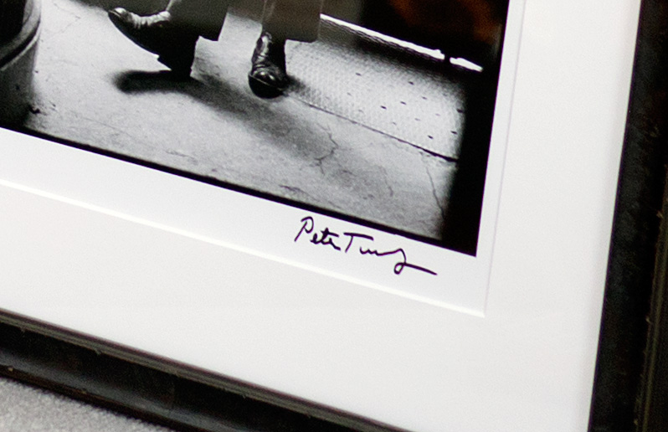
Different matting within standard sized mats
Size your print to have the image’s white border visible inside the mat window – for signing or esthetics

Slide 8
Mat colors – many different shades of white
Mats in the white family come in dozens of tints including:
Berkshire - Polar White/Smooth White: very bright whites, smooth white is the whitest of all the shades
Decorative - Very White: a smooth bright white, very popular and the brightest white of the Decorative mats
Decorative - Arctic White: a neutral white, the most popular choice for artists
Decorative - Antique White: a slightly off-white, popular for those seeking a lighter shade of white
Conservation - Chalk/White Art: both fairly neutral whites, White Art is the most popular conservation mat as Chalk is slightly brighter
Conservation - Pure White/Off-White: both lighter/creamier shades of white, Off-White is a few shades creamier than Pure White

Slide 9
Characteristics of mat board
Thickness
Matboard is typically measured in ply. Mats come in either 4 ply, 6 ply or 8 ply
Core
The core is the material that the matboard is made of. It is revealed with the bevel cut, the inside edge of the mat, after a 45 degree cut is made. It functions as a secondary border and is typically 1/8" of an inch.
Core comes in three colors:
Standard/Cream Core: cheap and used in most retail shops for its low cost, but it will fade and yellow over many years of exposure to light. It will also become brittle.
White Core: true bright white and will retain its color over many years since it is acid free. Brings out the beauty of your art work much more than the cream core.
Black Core: true black and will retain its color over many years since it is acid free. Brings out the beauty of your art work much more than the cream core, particularly useful in black and white photos.
Acidity
The acidity of a matboard determines how long it will last. True acid free is only available with cotton-fibre based matboards, these are used for museum art that needs to preserved for hundreds of years. Paper mat that is made of wood-pulp is often called acid free as it will last for about 100 years. These are the Conservation/Archival brand of matboards and are sold by most frame shops. The more common paper mat, often called Decorative is not acid free but will still last many years.

Slide 10
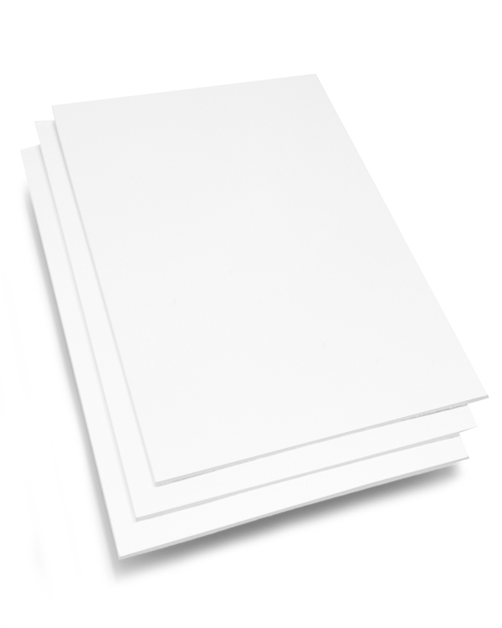
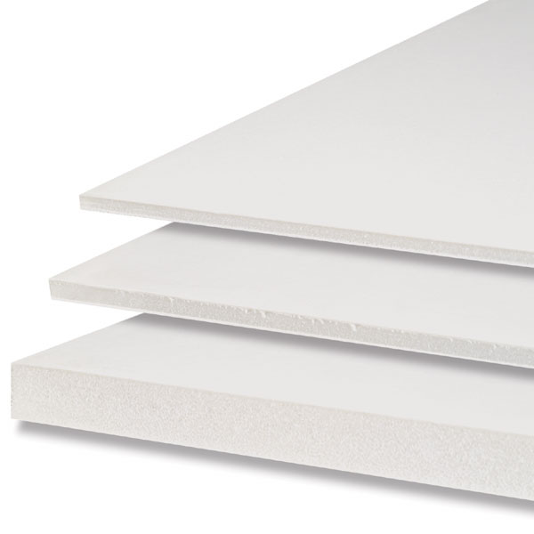
Backer board
Paper-based Core – typically 1/16” thick
Foam Core – typically 1/8” or 3/16” thick
Both come in Archival or non-archival

Slide 11
Competition Matting Rules
NVPS
Mounting is to consist of Polystyrene or Foam Core Backing Board either 1/8 or 3/16 in thickness
The Mat Board must be white
Mounted prints must not exceed 20 inches in height and 40 inches in width
All prints and Mat Boards must be securely mounted to the Backing Board
Nature Visions
Maximum outer dimensions are 16” x 20” (including matting).
Exception: Panoramas may be up to 24 inches on the longest side.
All mats and backing material must be white. They must also have white cores.
Cover window mats are required. Single matting is preferred. Double matting is permitted
The cover window mat must be securely affixed on all four sides to a firm backing of at least 3/16 inch foam core or similar material
A minimum 1.5 inch border (along all sides of the image) is required for photographs up to 8×10 inches. A minimum 2 inch border (along all sides of the image) is required for photographs larger than 8×10 inches. The border need not be the same on all sides

Slide 12
Cutting your own mats and backer board – hands on practice
Step 1 – Enter the dimensions of your print and mat size into the spreadsheet – it calculates the mat window size and borders
Step 2 – Go to one of the mat cutting work stations for a live demonstration – different cutting devices have different steps
Step 3 – Cut your own mat and backer board
Step 4 – Go to the assembly station to mount your print and assemble your matted image
Note: If you have a pre-cut mat and backer board, you can go directly to the assembly station to put it all together

