Slide 1
PHOTOGRAPHING FLOWERS
ON A LIGHTBOX
Prepared by Kieulan Nguyen

Slide 2
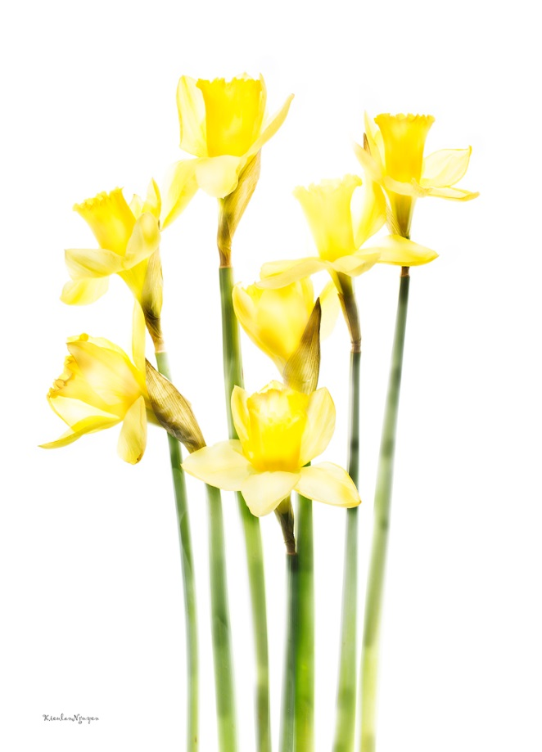
What are requirements for photographing flowers for translucency
A little history about this method - Inventor: Harold Davis – he invented a digital workflow and set of techniques involving specific kinds of back lighting that make it possible to create luminous translucent images.

Slide 3
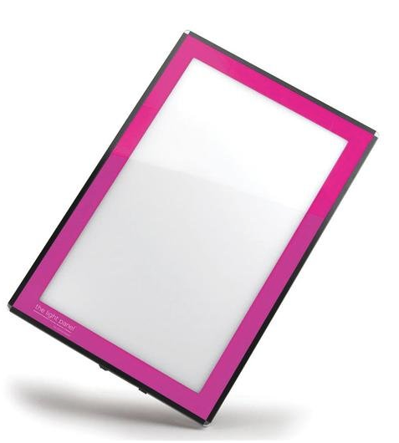
What do you need?
Camera
Lens – prefer macro lens
Tripod
Shutter Release cable
Lightbox
Wacom Tablet
Porta-Trace LED Light Panel

Slide 4
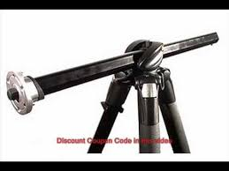
Photographing Flowers on a Light Box
Tripod – What kind of tripod for this type of photography : rapid center column in standard vertical mode or swing it into horizontal position.

Slide 5
Set Up for photographing flowers
Light box
A bunch of flowers.
Arranging flowers in a way that has a main support such as branches.
Place the camera facing down and parallel with the light box. If not the light will not be evenly distributed and we might catch some shadow.

Slide 6
Camera setting & Making images
Series of 7 to 10 images
Set evaluative metering
Set the lens to AUTO FOCUS and make sure that everything is in focus
Switch to Manual Focus
Switch the camera to MANUAL MODE
ISO is 100
Shutter speed starts at 1/30s
Change Aperture until we get the shutter speed of 1/30 or 1/40
Most of the time, I set the Aperture is f/9, f/11 or f/13
Start taking the first image as the marker. Use your hand to cover part of the lens so we know the series of photos will start after this picture.

Slide 7
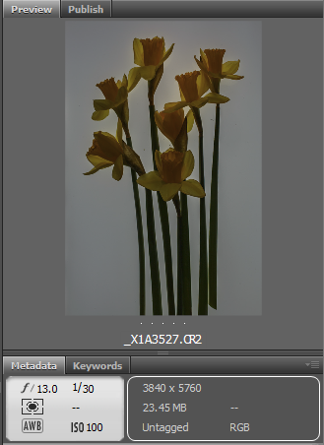
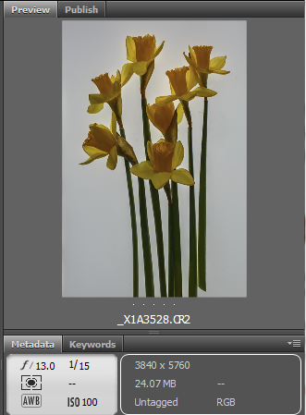
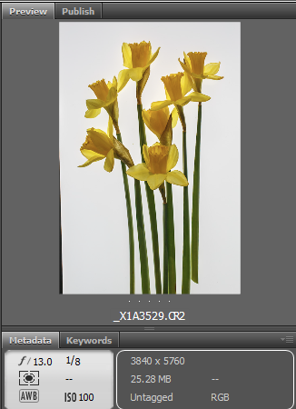
Series of images
Pic 1
Pic 2
Pic 3

Slide 8
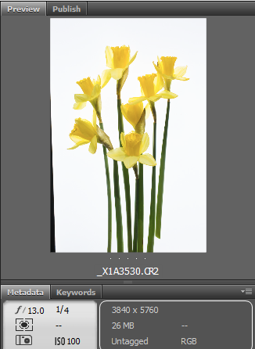
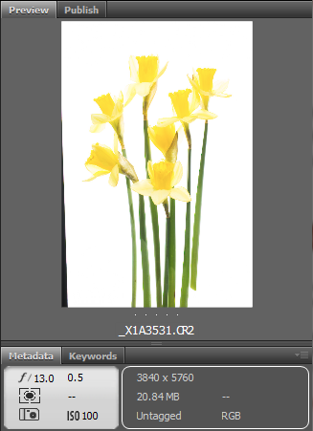
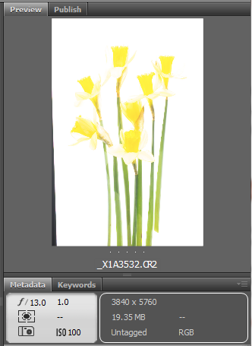
Series of images
Pic 4
Pic 5
Pic 6

Slide 9
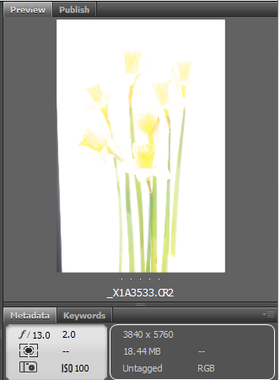
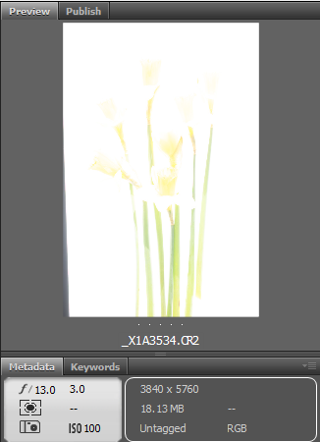
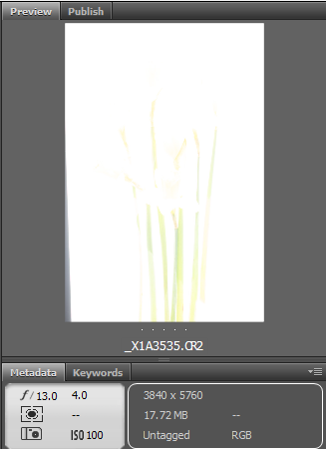
Series of images
Pic 7
Pic 8
Pic 9

Slide 10
How to Post-process in Photoshop

Slide 11
Load the most over-exposed image first (Pic #9) – Unlock the background layer and rename.
Load the next less over-exposed image (Pic #8) by copy and paste on top of pic #9.
Create a layer mask to start painting in.

Slide 12
4. Click on layer 3534 pic 8 then go to Menu
Layer → Layer Mask → Hide All
5. Select a soft brush
6. Set Opacity around 50% and 50% for Flow
7. Select B(Brush) and Press D to set the default for layer mask
8. Select White since we work with black mask
9. Start to paint in

Slide 13
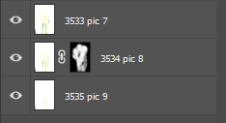
Select next image (Pic #7) and copy and paste on Pic #8
Select all layers – Edit → Auto Align Layer - this is to ensure that all layers are lined up correctly. If not, when paint in, there will have halo effect
Reduce Opacity level to 25% or 30%
Create black mask and start paint in.

Slide 14
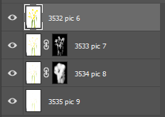
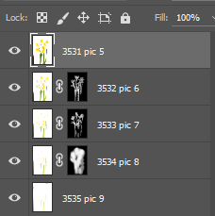
13. Select the next image (Pic #6) and copy and paste on top of Layer Pic 7.
Repeat Step 10 and Step for other images.
Create black mask and start paint in. Reduce Opacity to 25-30%

Slide 15
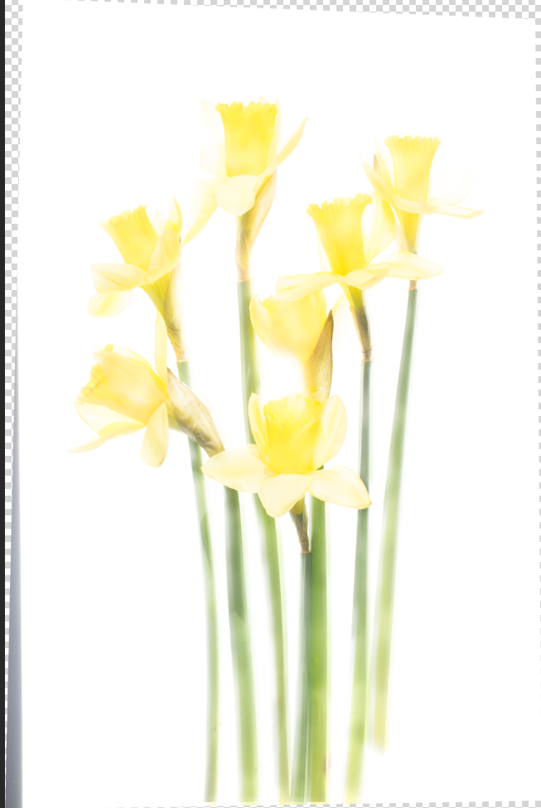
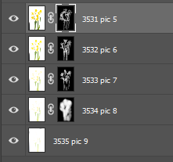
After 5 images - create definition of the flowers – the edges

Slide 16
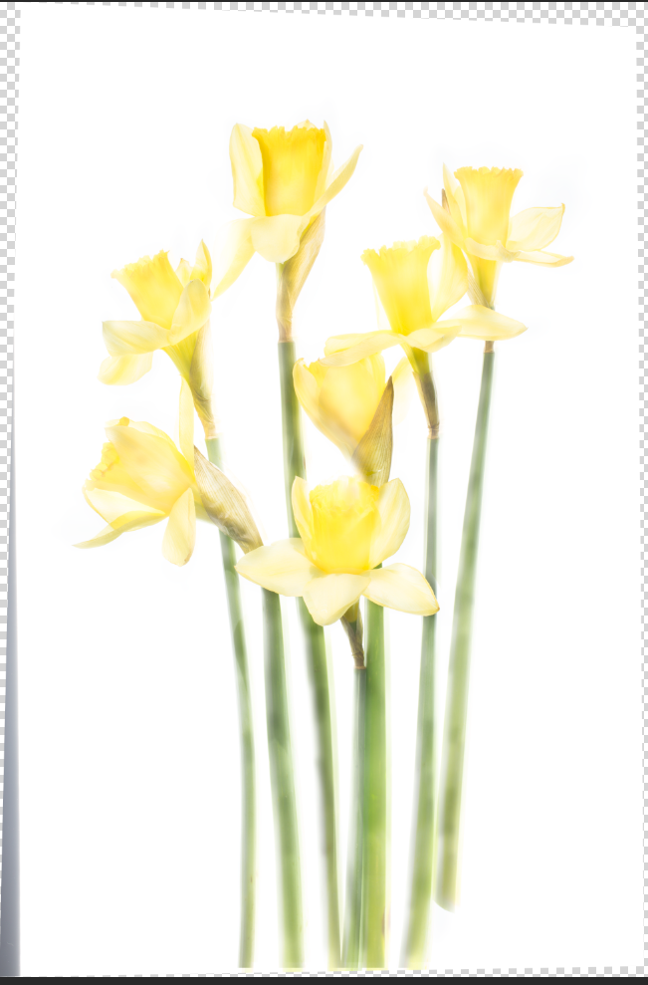
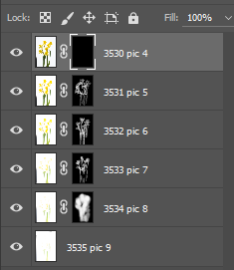
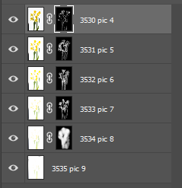
Copy and paste the next image (pic #4) and repeat the process like describing in step 10 through 12
The last image is HDR. This image is used to add more definition and create depth and boost the colors

Slide 17
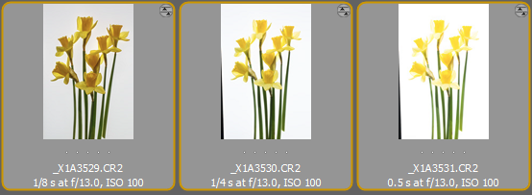
Create HDR Image – select 3 images
Use Nik HDR or other Plug in like Aurora, Photomatix
Create HDR image using Adobe Raw

Slide 18
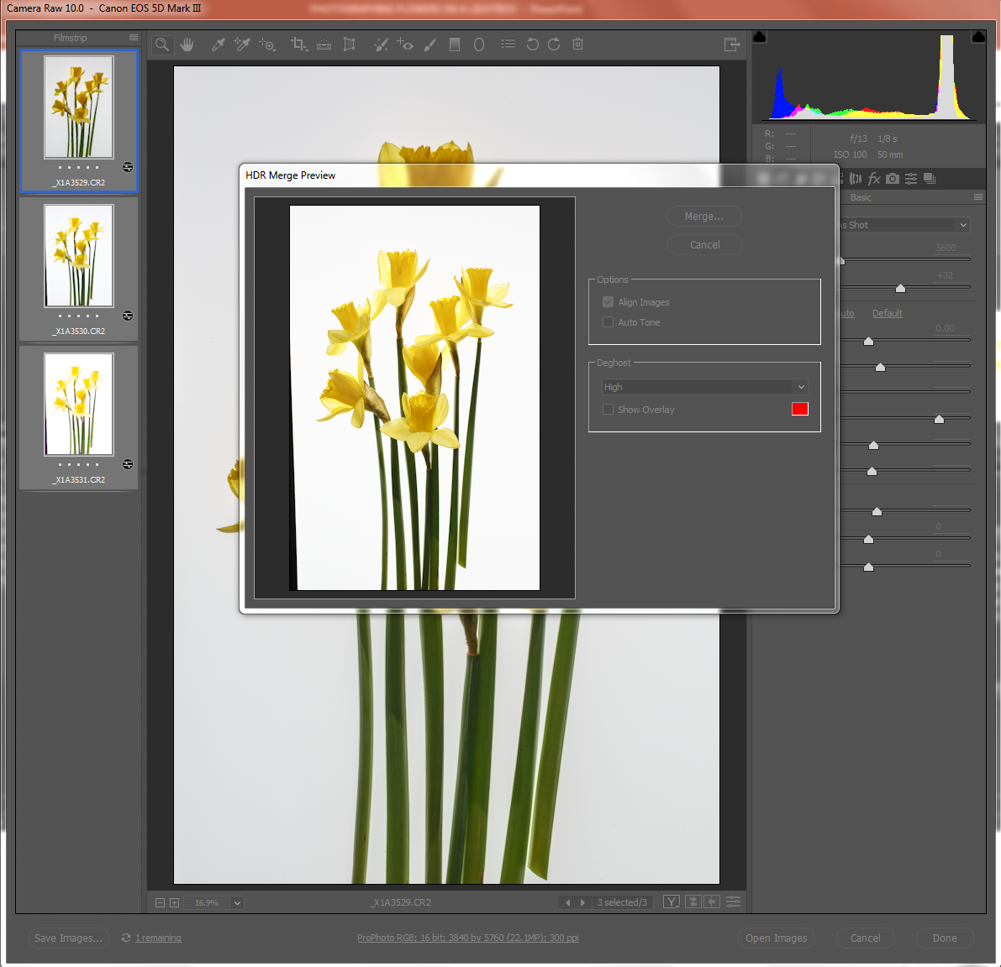
Open the folder where images are. Select 3 images to be merged.
Click Merge Dialog

Slide 19
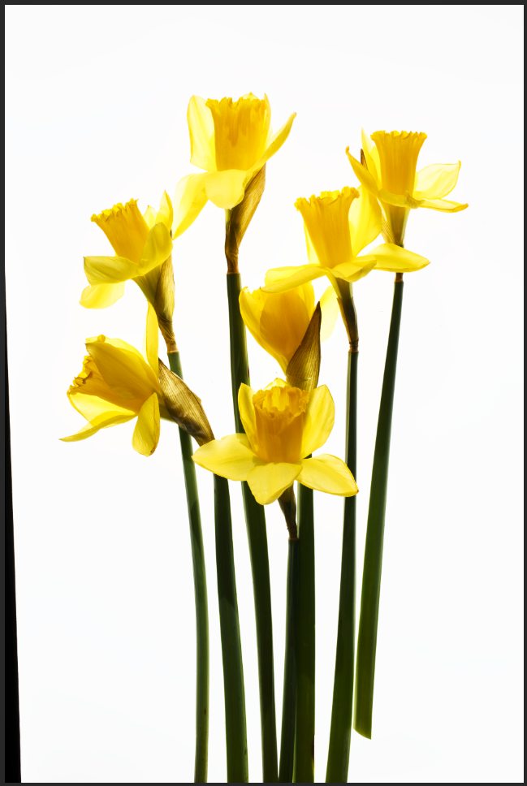
Create adjustment curve layer to create more contrast and color
Copy and paste the HDR layer onto the last layer (Pic 4)
Repeat step 10 through step 12

Slide 20
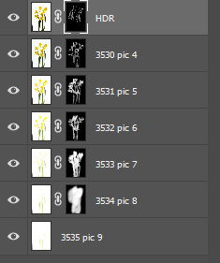
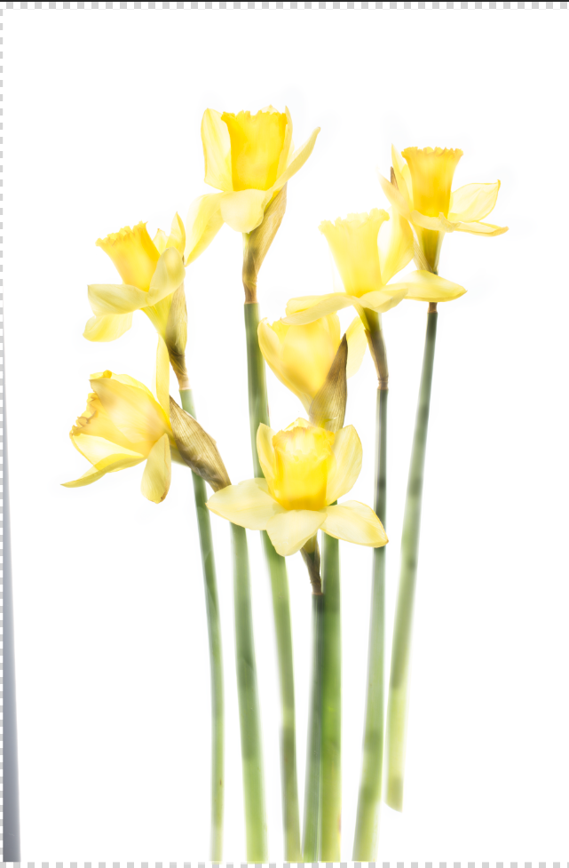
Final look
Tidy up – Crop
Optional: Can apply texture or create painterly look by using Topaz plug in.

Slide 21
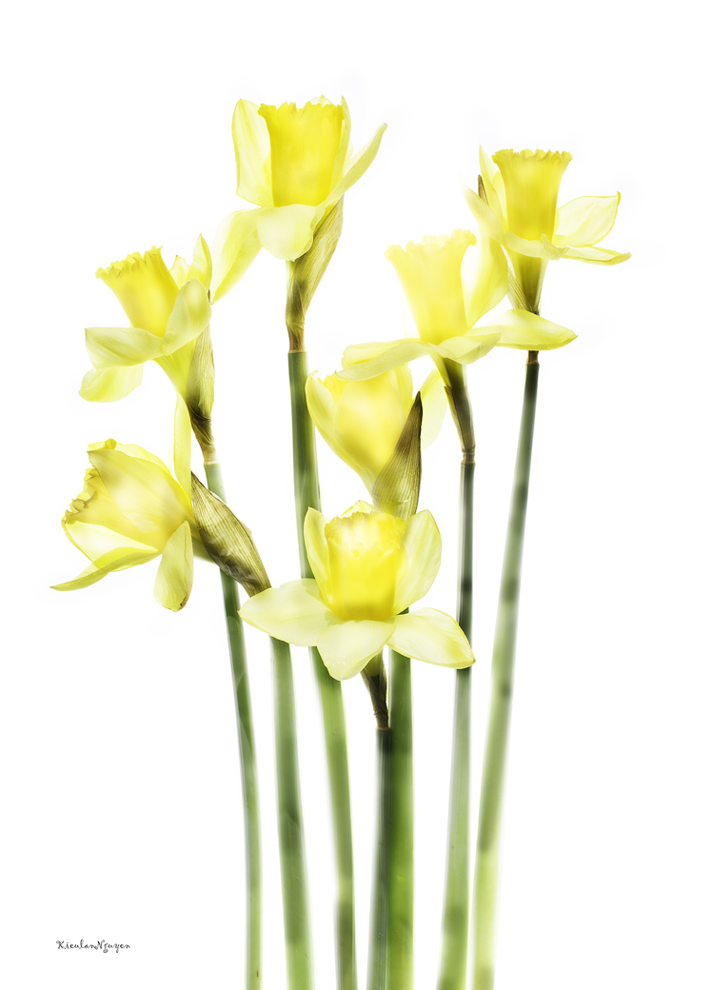
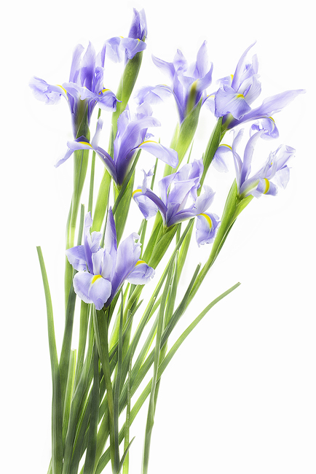
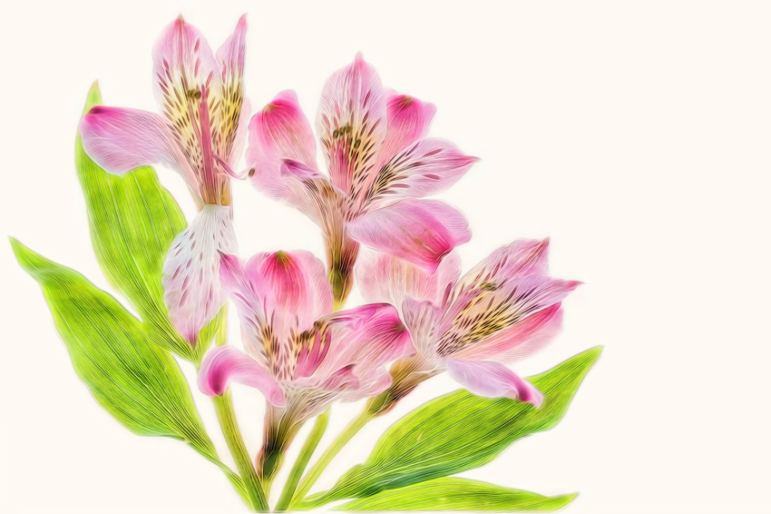

Slide 22
THANK YOU
If you have any questions, please feel free to send me an email to: Kieulan.nguyen@gmail.com
If you need to have these images to practice, please also let me know. I will be happy to share them with you.

